Slide 1
Notes:
NPM, apt get, brew install
Helm is a package manager like Homebrew, apt, and yum, and it’s the defacto standard for packaging and deploying Kubernetes applications. Microsoft donated Helm to the Cloud Native Computing Foundation (CNCF) back in June 2018, and it’s on track for graduation in 2020. Helm was used by 68% of respondents of a CNCF user survey. And it was the 3rd most popular project at the last KubeCon in Barcelona. We use Helm in AKS, azure dev spaces, azure pipelines, azure devops.

Slide 2
Helm helps you manage Kubernetes applications — Helm Charts help you define, install, and upgrade even the most complex Kubernetes application.
Manage Complexity
Charts describe even the most complex apps, provide repeatable application installation, and serve as a single point of authority.
Easy Updates
Take the pain out of updates with in-place upgrades and custom hooks.
Simple Sharing
Charts are easy to version, share, and host on public or private servers.
Rollbacks
Use helm rollback to roll back to an older version of a release with ease.
Notes:
The basics of how Helm works: It makes it easier to:
define your applications in YAML
update your applications in a consistent, repeatable way
share public or private charts
re-deploy old versions

Slide 3
The Purpose of Helm
Helm is a tool for managing Kubernetes packages called charts. Use existing charts or create your own. Helm can do the following:
Create new charts from scratch
Package charts into chart archive (tgz) files
Interact with chart repositories where charts are stored
Install and uninstall charts into an existing Kubernetes cluster
Manage the release cycle of charts that have been installed with Helm

Slide 4
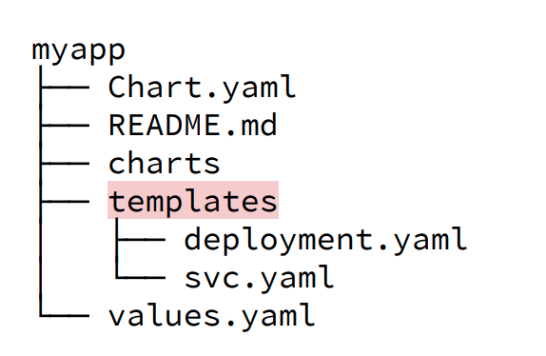
Helm – Key Concepts
The chart is a bundle of information necessary to create an instance of a Kubernetes application.
The config contains configuration information that can be merged into a packaged chart to create a releasable object.
A release is a running instance of a chart, combined with a specific config.

Slide 5
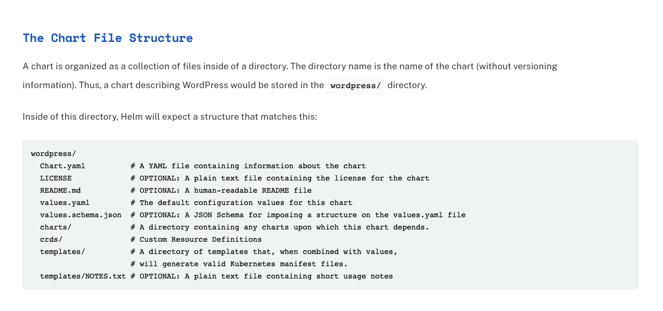
Helm – Key Concepts

Slide 6
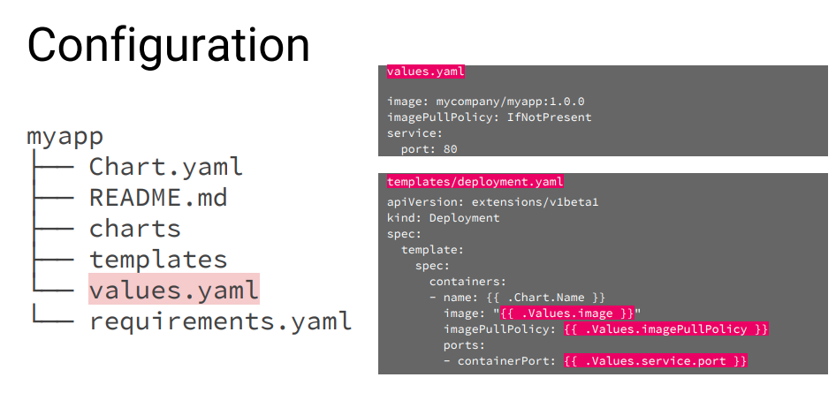

Helm – Values and Templates

Slide 7
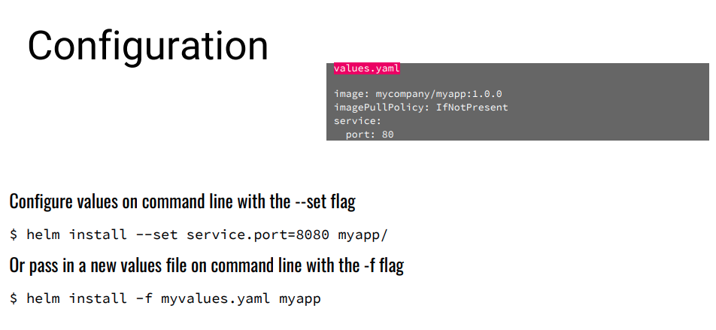
Helm – Values and Templates

Slide 8
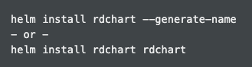
v3 Overview
Based on community best practices
Dramatic simplification
Architectural changes (security as priority)
Removal of Tiller
Name (or --generate-name) is now required on install
https://helm.sh/docs/faq/
Notes:
Helm 2 was already simple. If we install the same Helm chart with Helm 2 and Helm 3, the application installed will be precisely the same, just as we would expect! So, what’s the motivation behind Helm 3? Helm 3 is the result of years of community contributions and feedback around how orgs are using Helm and how they need it to evolve for their production use cases. Helm 3 represents a nearly complete re-factoring of the Helm package manager to evolve it from its origins to a modern application package manager. The Helm project is nearly as old as Kubernetes itself. As a result, its original design pre-dated many advancements in Kubernetes like CustomResourceDefinitions and even Kubernetes RBAC.

Slide 9
Helm – Resources
Documentation: helm.sh/docs
Video: Helm Intro
Video: Helm 3 Deep Dive
Helm Charts on GitHub

Slide 10
Whiteboard & Demo
Charts
Architecture
Helm install
Revisions
Rollback

